Slide 1
INTERMEDIATE CODE GENERATION

Slide 2

Phases of Compiler
 |  | Input Source Program
 |  | ↓
 |  | Lexical Analyzer
 |  | ↓
 |  | Syntax Analyzer
 |  | ↓
Symbol Table Manager |  | Semantic Analyzer |  | Error Handler
 |  | ↓
 |  | Intermediate Code Generator
 |  | ↓
 |  | Code Optimizer
 |  | ↓
 |  | Code Generator
 |  | ↓
 |  | Target Program

Slide 3
Intermediate Code
Defined as
The source code of a program is translated into a form called intermediate code which is suitable for code improvement and transformations before use to generate object or machine code for a target machine.

Slide 4
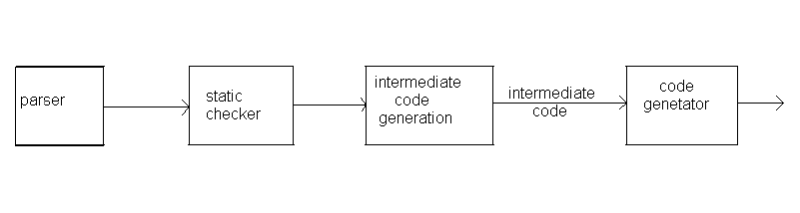
Intermediate Code Generation
Translate the source program Such as
  declarations,
  assignments and
  flow-of-control statements
into an intermediate form

Slide 5
Intermediate Languages
Three types of intermediate representations
Syntax Trees
2. Postfix notation
3. Three Address Code

Slide 6
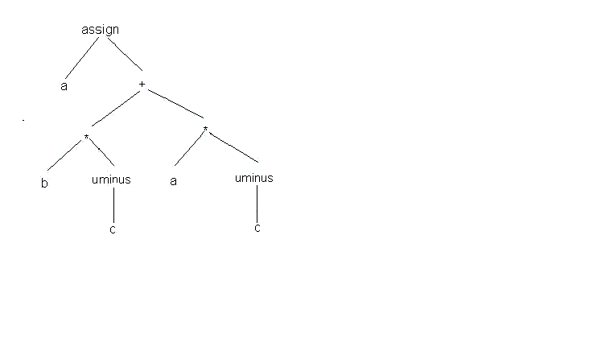
Graphical Representations
A syntax tree depicts the natural hierarchical structure of a source program.
Ex. A syntax tree for the assignment statement
a:=b*-c+a*-c

Slide 7
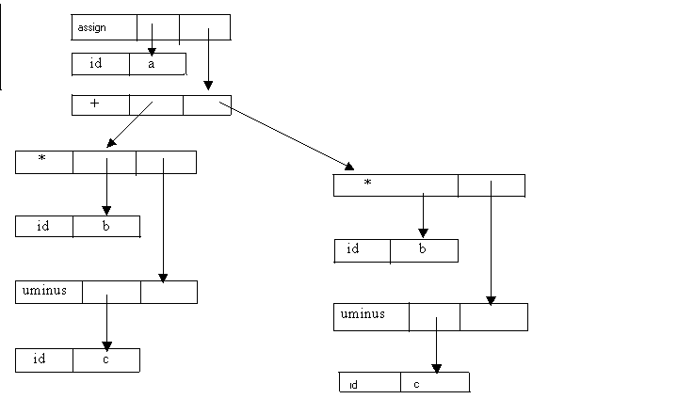
Graphical Representations
There are two representations of the syntax tree.
  Tree and array of records
Each node is represented as a record with a field for its operator and additional fields for pointers to its children.
All the nodes in the syntax tree can be visited by following pointers, starting from the root at position .

Slide 8
Graphical Representations
All nodes are allocated from an array of records and the index or position of the node serves as the pointer to the node.
0
id
b
1
id
c
2
uminus
1
3
*
0
2
4
id
a
5
id
c
6
uminus
5
7
*
4
6
8
+
3
7
9
id
a
10
assign
9
8
11
……

Slide 9
Three-Address Code
A three-address statement is an abstract form of intermediate code.
Three-address code is a sequence of statements of the form
x:= y op z
where x, y, and z are names, constants, or compiler-generated temporaries;
op stands for any operator, such as arithmetic operator, or a logical operator on Boolean-valued data.
The reason for the term ”three-address code” is that each statement usually contains three addresses, two for the operands and one for the result.

Slide 10
Three-Address Code(Cont…)
No arithmetic expressions are permitted, as there is only one operator on the right side of a statement
Thus expression like x+y*z might be translated into a sequence
t₁: = y*z
t₂:=x+t₁
where t1 and t2 are compiler-generated temporary names.

Slide 11
Three-Address Code(Cont…)
The use of names for the intermediate values computed by a program allow- three-address code to be easily rearranged
a : = b*-c + a*-c
t1 := -c
t2 := b * t1
t3 := -c
t4 := a * t3
t5 := t2 + t4
a := t5

Slide 12
Three-Address Code : Types
Assignment statements of the form x: = y op z, where op is a binary arithmetic or logical operation.
Assignment instructions of the form x: = op y, where op is a unary operation.
  Unary operations include
  unary minus, logical negation, shift operators, and conversion operators.

Slide 13
Three-Address Code : Types
Copy statements of the form x: = y where the value of y is assigned to x.
The unconditional jump goto L. The three-address statement with label L is the next to be executed.
Conditional jumps such as if x relop y goto L. This instruction applies a relational operator (<, =, >=, etc.)

Slide 14
Three-Address Code : Types
param x and call p, n for procedure calls and return y, where y representing a returned value that is optional.
param x1
param x2
param xn
call p, n

Slide 15
Three-Address Code : Types
Indexed assignments of the form x: = y[ i ] and x [ i ]: = y.
  The statement x[i]:=y sets the contents of the location i units beyond x to the value of y.
Address and pointer assignments of the form x:= &y, x:= *y and *x: = y.

Slide 16
Implementations of three-Address Statements
Three address statements can be implemented as records with fields for the operator and the operands.
Three such representations are
  quadruples
  triples
  indirect triples.

Slide 17
Implementations of three-Address Statements
Quadruples
A quadruple is a record structure with four fields
  op, argl, arg2, and result.
  The op field contains an internal code for the operator.
  The three-address statement x := y op z is represented by placing y in arg1, z in arg2 and x in result.
  Statements with unary operators like x: = – y or x: = y do not use arg 2.

Slide 18
Implementations of three-Address Statements
Quadruples
Operators like param use neither arg2 nor result.
Conditional and unconditional jumps put the target label in result.
t1 := -c
t2 := b * t1
t3 := -c
t4 := a * t3
t5 := t2 + t4
a := t5
op
Arg1
Arg2
Result
(0)
uminus
c
t1
(1)
*
b
t1
t2
(2)
uminus
c
t3
(3)
*
a
t3
t4
(4)
+
t2
t4
t5
(5)
:=
t5
a

Slide 19
Implementations of three-Address Statements
Triples
  To avoid entering temporary names into the symbol table. refer to a temporary value by the position of the statement
  three-address statements can be represented by records with only three fields: op, arg1 and arg2.
  The fields argl and arg2, for the arguments of op, are either pointers to the symbol table or pointers into the triple structure.
  Since three fields are used, this intermediate code format is known as triples.

Slide 20
Implementations of three-Address Statements
op
Arg1
Arg2
Result
(0)
uminus
c
t1
op
Arg1
Arg2
(1)
*
b
t1
t2
(2)
uminus
c
t3
(0)
uminus
c
(3)
*
a
t3
t4
(4)
+
t2
t4
t5
(1)
*
b
(0)
(5)
:=
t5
a
(2)
uminus
c
Quadruples
t1 := -c
t2 := b * t1
t3 := -c
t4 := a * t3
t5 := t2 + t4
a := t5
(3)
*
a
(2)
(4)
+
(1)
(3)
(5)
:=
a
(4)
Triples

Slide 21
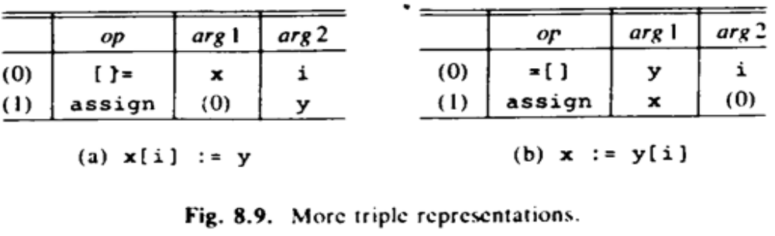
Implementations of three-Address Statements
A ternary operation like x[ i ]: = y requires two entries in the triple structure.

Slide 22
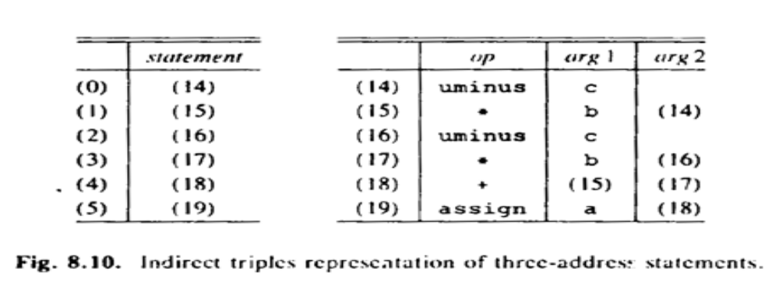
Implementations of three-Address Statements
Indirect Triples
  Listing pointers to triples, rather than listing the triples themselves.
  This implementation is naturally called indirect triples.
  Use an array statement to list pointers to triples in the desired order

Slide 23
Comparison of the Implementations
Using the quadruple notation, a three- address statement a temporary can immediately access the location via the symbol table.
In the triples declaration; moving a statement that defines a temporary value requires to change all references to that statement in the arg1 and arg2 arrays.
This problem makes triples difficult to use in an optimizing compiler.

Slide 24
Comparison of the Implementations
Indirect triples present no such problem. A statement can be moved by reordering the statement list.
Indirect triples can save some space compared with quadruples if the same temporary value is used more than once.
The reason is that two or more entries in the statement array can point to the same line of the op-arg1-arg2 structure.

Slide 25
Syntax-Directed Translation into Three-Address Code
When three-address code is generated, temporary names are made up for the interior nodes of a syntax tree.
The value of non-terminal E on the left side of E → E1 + E2 will be computed into a new temporary t.

Slide 26
Syntax-Directed Definition
The attribute S.code represents the three- address code for the assignment S. The non-terminal E has two attributes:
  E.place, the name that will hold the value of E, and
  E.code, the sequence of three-address statements evaluating E.

Slide 27
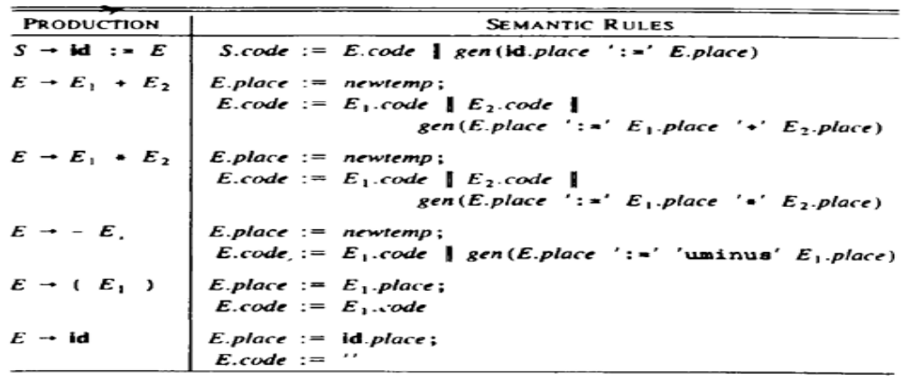
Syntax directed translation for assignment
The function newtemp returns a sequence of distinct names t1, t2,... in response to successive call
Semantic rules are the agreed definitions of statements.

Slide 28
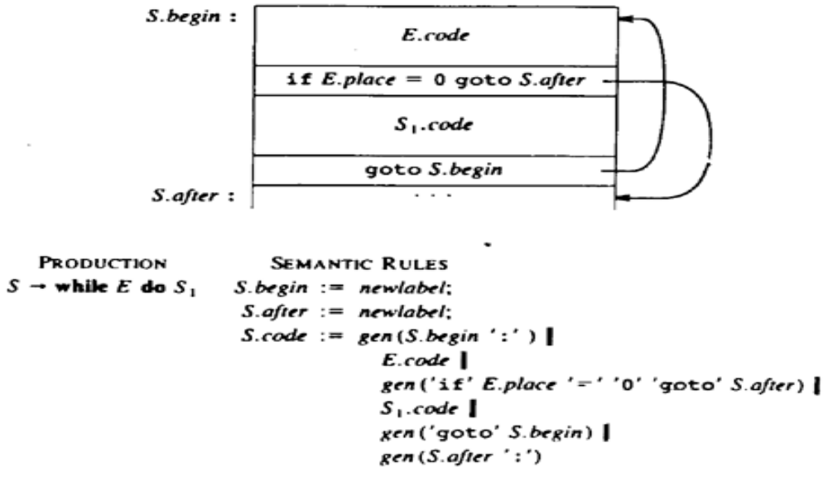
Semantic rules generating code for while loop
Semantic rules for generating code for while statement
S-> while E do S₁

Slide 29
Declarations
A global variable, offset, can keep track of the next avai1able relative address.
Non-terminal P generates a sequence of declarations of the form id: T. Before the first declaration is considered, offset is set to 0.
P → D {Offset=0 }
D → D ; D
D → id : T {enter (id.name, T.type, offset); //creates a symbol table
Offset:= offset + T.width }
T → integer {T.type := integer;
T.width := 4}
T → real {T.type := real;
T.width := 8}
T → array [num] of T1 {T.type := array (num.val, T1.type);
T.width := num.val × T1.width}
T → *T1 {T.type := pointer (T.type);
T.width:= 4}

Slide 30
Keeping Track of Scope Information
When a nested procedure is seen, processing of declarations in the enclosing procedure is temporarily suspended. This approach will be illustrated by adding semantic rules to the following language.
P → D
D → D;D | id: T | proc id; D;S
A new symbol table is created when a procedure declaration D proc id D₁;S is seen, and entries for the declarations in D₁ are created in the new table. S is statements of the proc.
The new table points back to the symbol table of the enclosing procedure;

Slide 31
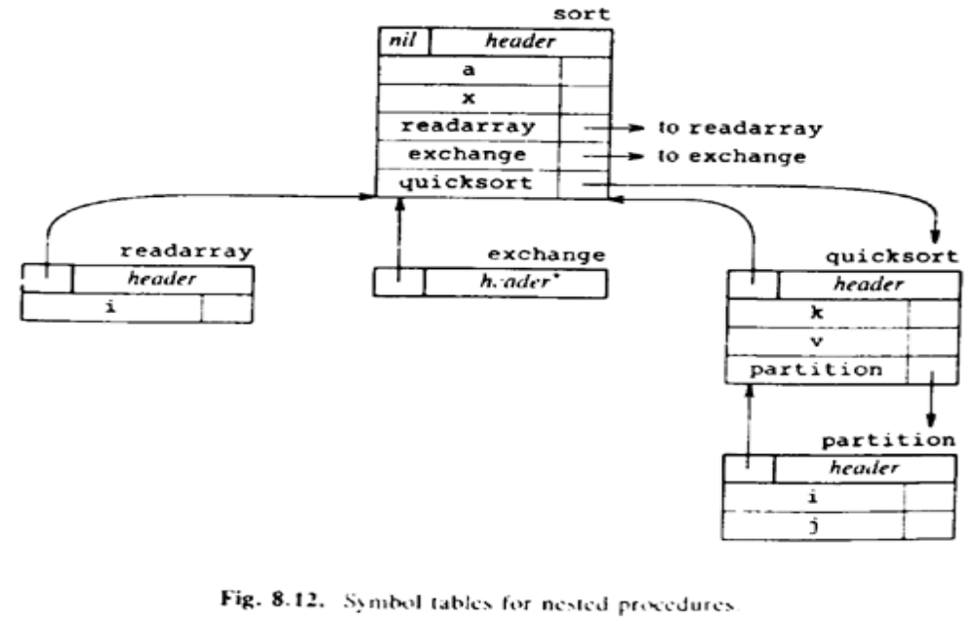
Symbol table for nested procedures

Slide 32
Assignment Statement
How names can be looked up in the symbol table
How elements of arrays and records can be accessed
Emit() to emit three-address statements to an output file
Operation lookup (id.name) checks
  if there is an entry for this occurrence of the name in the symbol table.
  If so, a pointer to the entry is returned;
  otherwise, lookup returns nil to indicate that no entry was found.

Slide 33
Assignment Statement
S → id := E {p=lookup(id.name);
if p!=nil then emit(P ’:=’ E.place)
else error }
E → E1 + E2 {E.place := newtemp;
emit(E.place ‘:=’E1.place ‘+’ E2.place)}
E → E1 * E2 {E.place := newtemp;
Emit(E.place ‘:=’ E1.place ‘*’ E2.place)}
E → -E1 {E.place := newtemp;
Emit(E.place ‘:=’ ‘uminus’ E1.place)}
E → ( E1 ) {E.place := E1.place }
E → id { p:= lookup(id.name);
If p != nil then E.place := p
else error}

Slide 34
Reusing Temporary Names
newtemp generates a new temporary name each time a temporary is needed.
It is useful, especially in optimizing compilers, to actually create a distinct name each time newtemp is called.
The temporaries used to hold intermediate values in expression calculations
Space has to be allocated to hold their values.

Slide 35
Reusing Temporary Names
The code generated by the rules for
E→ E1 + E2 has the general form:
evaluate E1 into t1
evaluate E2 into t2
t:= t1 + t2
From the rules E.place it follows that t1 and t2 are not used elsewhere in the program.
The lifetimes of all temporaries used in the evaluation of E1 are contained in the lifetime of t1.

Slide 36
Reusing Temporary Names
Let us assume for simplicity that we are dealing only with integers.
Keep a count c, initialized to zero.
Whenever a temporary name is used as an operand, decrement c by 1.
Whenever a new temporary name is generated, use $c and increase c by 1.

Slide 37
Reusing Temporary Names
Statement | Value of c
 | 0
$0:= a * b | 1
$1:= c * d | 2
$0:= $0 + $1 | 1
$1:= e * f | 2
$0:= $0 - $1 | 1
x := $0 | 0
x:=a*b+c*d-e*f
t1=a*b
t2=c*d
t3=t1+t2
t4=e*f
t5=t3-t4
x:=t5

Slide 38
Addressing Array Elements
Elements of an array can be accessed quickly if the elements are stored in a block of consecutive locations.
If the width of each array element is w, then the i^{th} element of array A begins in location
base + (i – low) × w
low is the lower bound on the subscript; base is the relative address of A[low]. Can be written as
i×w + (base – low×w)
c= base – low×w can be evaluated during declaration.
If c is saved in the symbol table, the relative address of A[i] is obtained by simply adding i × w to c

Slide 39
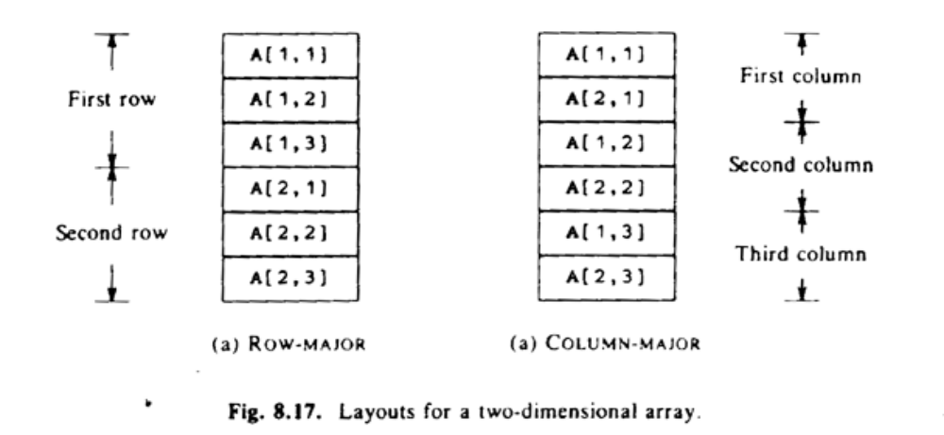
Addressing Array Elements
A two-dimensional array is normally stored in one of two forms, either row-major or column-major.
Layout of a 2 × 3 array , If the no. of dimension is n then ordering is n!

Slide 40
Addressing Array Elements
In the case of a two-dimensional array stored in row-major form, the relative address of A[i1,i2] can be calculated by the formula
base + ((i1 – low1) × n2 + i2 – low2) × w
  where low1 and low2 are the lower bounds on the values of i1 and i2
  n2 is the number of values that i2 can take (length of dimension). if high2 is the upper bound on the value of i2, then
  n2 = high2 – low2 + 1.
  i1 and i2 are the only values that are not known at compile time,
  rewrite the above expression as
  ((i1 * n2) + i2) × w + (base – ((low1 × n2) + low2) × w)
  The last term can be determined at compile time

Slide 41
Addressing Array Elements
Generalization of A[i₁, i₂,..., i_{k}]
(( …((i₁n₂+i₂)n₃+i₃)… )n_{k} + i_{k}) × w + base – (( …((low₁ n₂ + low₂) n₃ +low₃)… )n_{k} + low_{k}) × w
Since for all j, n_{j} = high_{j} – low_{j}+ 1 is assumed fixed
The 2nd term can be computed in the compile time.

Slide 42
Addressing Array Elements
A be a 2D int Array 10*20
Low1=low2=1, n1=10, n2=20
x:=A[y,z]
The three address code
      t1:=y*20
      t1:=t1+z
      t2:=c //c=base-84
      t3=4*t1
      t4:=t2[t3]
      x:=t4
  ((i1 * n2) + i2) × w +
  (base – ((low1 × n2) + low2) ×w)
((y *20) + z) X w
(base – ((1 X20) + 1 ) X 4)

Slide 43
INTERMEDIATE CODE GENERATION
Type Conversions
The semantic rule for E.type associated with the production E → E1 + E2 is:
E → E1+E2
{
E.type := if E1.type = integer and
E2.type = integer
then integer
else real
}

Slide 44
INTERMEDIATE CODE GENERATION
E.place := newtemp;
if E1.type = integer and E2.type = integer then
begin
emit(E.place’:=’ E1.place ’int+’ E2.place);
E.type: = integer
end
else if E1.type = real and E2.type = real then
begin
emit (E.place ’:=’ E1.place ’real +’ E2.place);
E.type := real
end
else if E1.type = integer and E2.type = real then
begin
u := newtemp;
emit(u ’:=’ ’inttoreal’ E1.place);
emit(E.place ’:=’ u ’real+’ E2.place);
E.type:= real
end

Slide 45
INTERMEDIATE CODE GENERATION
else if E1.type = real and E2.type = integer then
begin
u := newtemp;
emit(u ’:=’ ’inttoreal’ E2.place);
emit(E.place ’:=’ E1.place ’real+’ u);
E.type: = real
end
else
E.type:= type error;

Slide 46
INTERMEDIATE CODE GENERATION
BOOLEAN EXPRESSIONS
Boolean operators: AND, OR, NOT.
Form E1 relop E2
Relop <,>,=,<=,…
Grammer
  E→ E or E⏐ E and E ⏐ not E ⏐ (E) ⏐ id relop id ⏐ true ⏐ false
Nonzero true and zero false
a or b and not c (Three address code)
  t1=not c
  t2=b and t1
  t3=a or t2

Slide 47
INTERMEDIATE CODE GENERATION
a<b equivalent to if a<b then 1 else 0
Three address code
  100: if a<b goto 103
  101: t=0
  102: goto 104
  103: t:=1
  104:

Slide 48
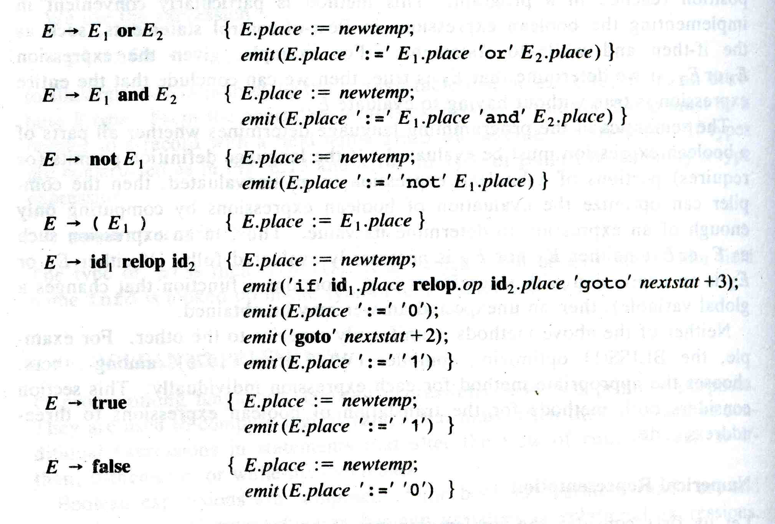
INTERMEDIATE CODE GENERATION

Slide 49
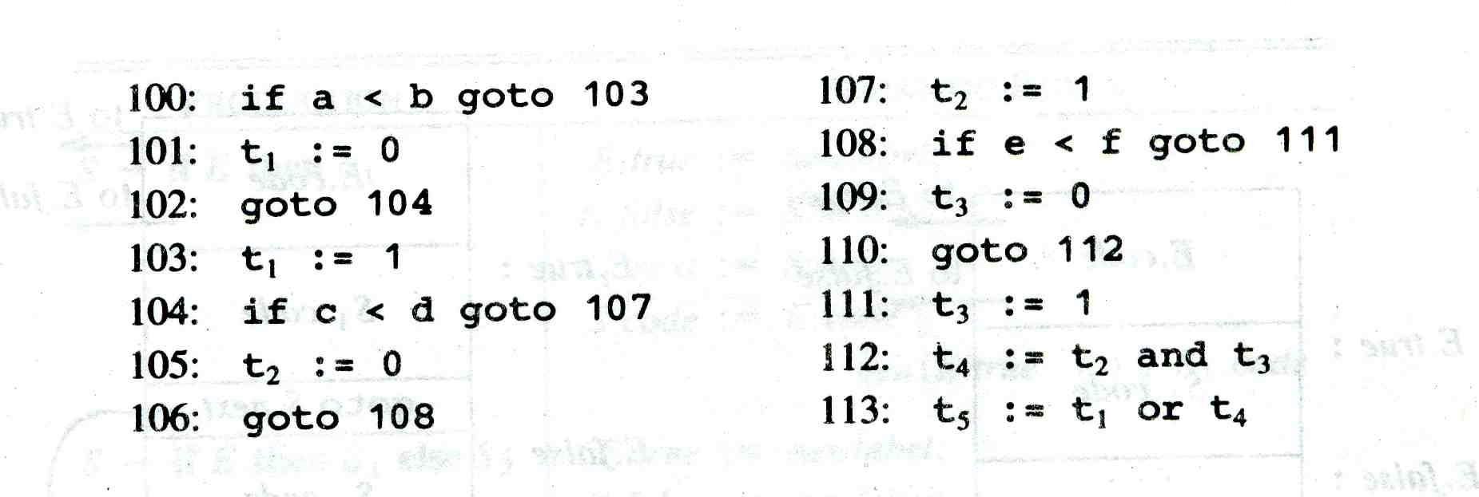
INTERMEDIATE CODE GENERATION
a<b or c<d and e<f

Slide 50
INTERMEDIATE CODE GENERATION
Flow of control Statement
Grammer
  S→if E then S1|
  if E then S1 else S2|
  while E do S1
  E is boolean expression to be translated
  E.True and E.flase controls the flow

Slide 51
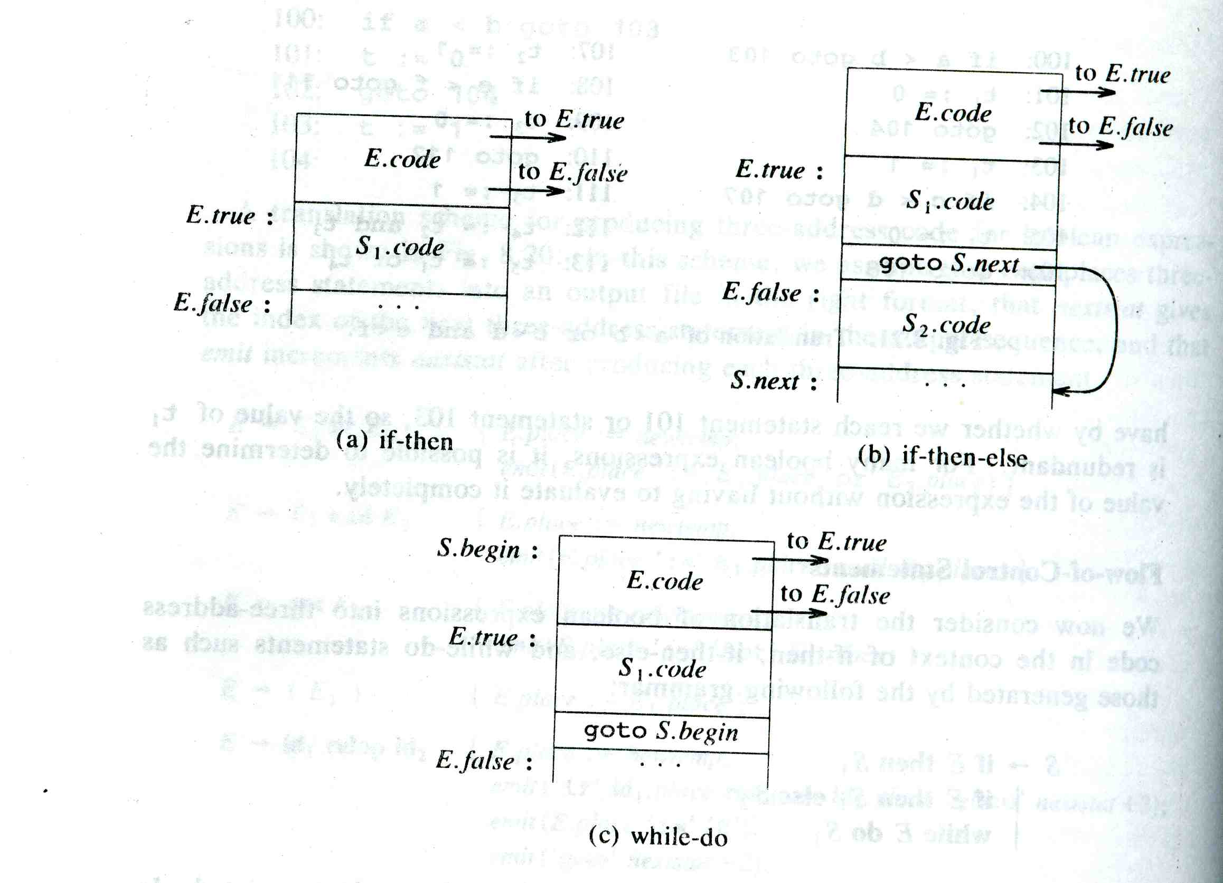
INTERMEDIATE CODE GENERATION
  a) if E then S1
  b) if E then S1 else S2
  c) while E do S1

Slide 52
INTERMEDIATE CODE GENERATION
Case Statements
  Switch E
    begin
      Case V1: S1
      Case V2: S2
      ….
      Case V_{n-1}: S_{n-1}
      Default: S_{n}
    end
Case Statements
  Switch expression
    Begin
      Case value: statement
      Case value: statement
      …
      Case value: statement
      Default: statement
    End

Slide 53
INTERMEDIATE CODE GENERATION
The translation of switch code is to
  Evaluate the expression
  Find the match in list of cases
    n way branch
    Can be implemented using goto
    Or create a table of pairs (value and level)
    Or hash table if n is very large. Construct array of levels
  Execute the statement with the value

Slide 54
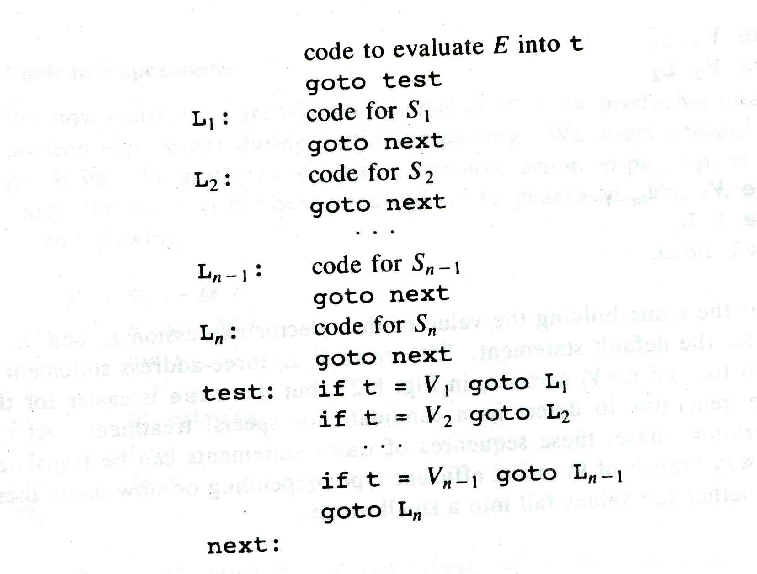
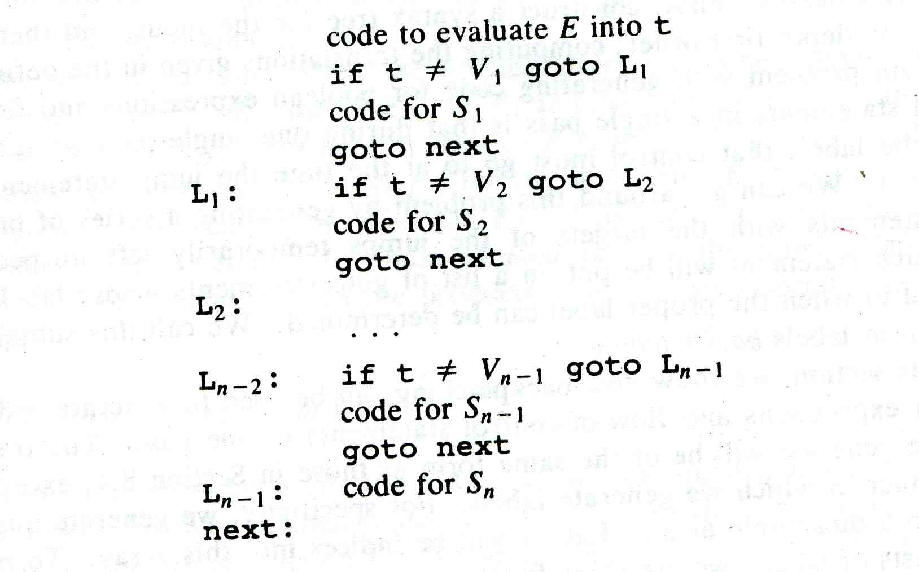
INTERMEDIATE CODE GENERATION

Slide 55

Thank You

